Slide 1
A Seminar on Product Authentication and Counterfeit Elimination Using Blockchain Technology
Team Details
K Vijaysimha(20EG105421)
R Chandravikas(20EG105438)
T Sai Kumar(20EG105445)
Project Supervisor
Dr B.V.V.Siva Prasad
Associate Professor

Slide 2
Introduction
Blockchain is a distributed ledger technology that provides a secure and transparent system for tracking and verifying transactions.By using blockchain, it becomes possible to create a tamper-proof system for product authentication. where every product is assigned a unique identifier that can be traced throughout the supply chain.
Blockchain can be used to ensure that only genuine products are allowed to pass through the supply chain. This can be achieved through the use of smart contracts, which are self- executing contracts with the terms of the agreement

Slide 3
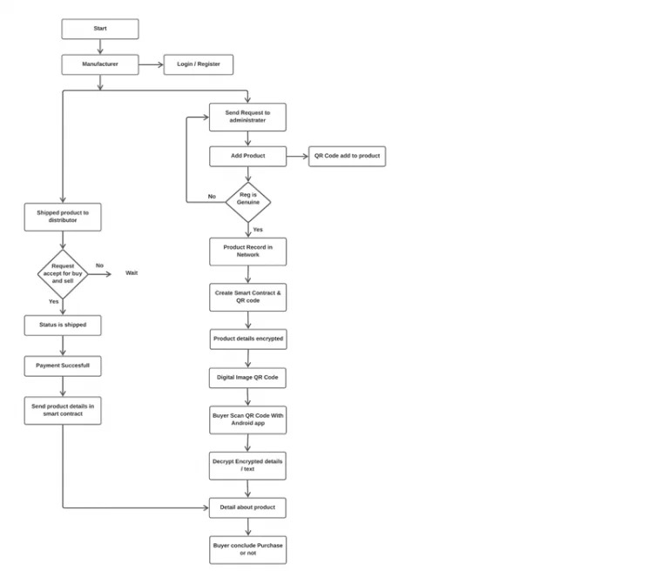
Concept Tree

Slide 4
Literature
Author(s) | Strategies | Advantages | Disadvantages
Zhang, Y., Wang, Y., & Zhang, L. | Blockchain-based system for anti-counterfeiting and traceability. | More effective in anti-counterfeiting and traceability compared to traditional systems | Specific performance metrics or quantitative results not provided
J. Ma, S.-Y. Lin, X. Chen, H.-M. Sun, Y.-C. Chen, and H. Wang | Decentralized Blockchain technology approach for consumer reliance reduction. | Consumers not fully reliant on merchants for product authenticity. | No specific details on system implementation or performance evaluation.
S. Underwood | Blockchain's capabilities beyond cryptocurrencies, revolutionizing industry and commerce. | Immutable, transparent, and redefines trust. Enables secure, fast, trustworthy, and transparent solutions. | General overview without specific focus on anti-counterfeiting traceability

Slide 5
Problem Statement
Counterfeit products can pose serious risks to consumers, brand reputation, and economic stability, and blockchain technology offers a robust solution to mitigate these issues.
Trust issues in transactions with third parties lead to increased costs and delays. Blockchain technology, exemplified by Bitcoin, eliminates intermediaries, offering transparency and reduced transaction costs.
Current centralized supply chain authentication, prone to failures, demands innovation. We propose the block-supply chain, leveraging blockchain and NFC[Near Field Communication] technologies, with a decentralized consensus protocol ensuring efficiency and security.

Slide 6
Problem Illustration
Example:1. Manufacturer Registration
- Manufacturer: ABC Electronics
- Manufacturer ID: ABC123
- Status: Registered on Blockchain
2. Product Registration
- Product: Smartphone XYZ
- QR Code: ABCXYZ789
- Encryption: Smart contract with product details
- Status: Registered on Blockchain
3. Regulator Verification
- Regulator Approval: Approved
- Status: Manufacturer and Product Verified on Blockchain
4. QR Code Protection
- Copy-Sensitive Digital Image Embedded
- Status: QR Code Secured

Slide 7
Problem Illustration
5.Product Shipment
- Distributor: XYZ Distributors
- Status: Shipping
- Blockchain Updated: Ownership remains with ABC Electronics
6. Ownership Transition
- Purchase Request from XYZ Distributors
- Payment: $500
- Smart Contract Execution
- Ownership Transfer: ABC Electronics to XYZ Distributors
- Status: Completed
7. Customer Interaction
- Consumer Android App Provided
8. QR Code Scanning
- Consumer Scans QR Code (ABCXYZ789)
- Decryption: Retrieves Manufacturer and Owner Information
- Status: Information Displayed to Consumer

Slide 8
Problem Illustration
9. Purchase Decision
- Consumer Reviews Manufacturer (ABC Electronics) and Owner (XYZ Distributors) Information
- Smartphone XYZ Details Displayed
- Decision: Purchase for $500
10. Transaction Confirmation
- Consumer Makes Payment
- Status: Completed
- Blockchain Updated: Ownership reflects consumer as the new owner
11. End-to-End Verification
- Blockchain shows complete product journey from Manufacturer to Consumer
- Transparency and Authenticity Confirmed

Slide 9
Proposed Method
Blockchain technology is a distributed database where more than one server can be accessed at a time. Proposed system does not require any third party and verification is done.
In this to avoid forge counterfeit we are converting all product details into digital signatures and this digital signatures(unique hash code) will be stored in blockchain server.
Blockchain server supports tamper proof data storage and nobody can alter data . If its data alter verification get failed and user get intimation about data alter.

Slide 10
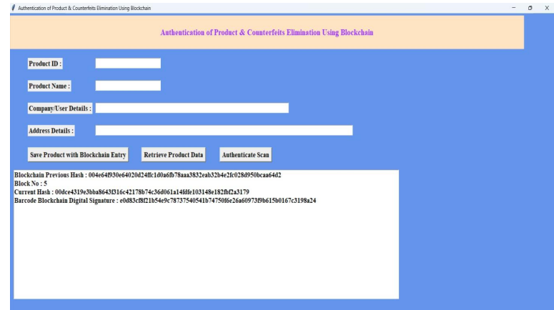
Proposed Method Illustration
.

Slide 11
Parameter
Verification of Digital Signature:
To verify a digital signature, the recipient uses the sender’s public key to check if the signature matches the data.
Formulae : Verification =Verify ( signature, Data, Public key)’
Tamper-Proof Features:
Tamper-proofing is achieved through the use of cryptographic hashes, digital signatures, and the decentralized nature of the blockchain network.
Formulas:
Digital Signature = Sign(Data, Private Key) Block Hash = Hash(Previous Block Hash + Transactions Data)
Verification = Verify(Signature, Data, Public Key)

Slide 12
Experiment Environment
VS code (Version – 1.85): It is an integrated environment used for coding and development.

Slide 13
Project status
S.No | Functionality | Status (Completed /in-progress/Not started)
1 | Set-up the experiment environment | Completed
2 | Implementing& importing the Hashlib's | Completed
3 | Set-up JSON and API's familiar to users of the standard library marshal and pickle modules | Completed
4 | Saving Product with Blockchain Entry | In-Progress
5 | Retrieve Product Data | Not started
6 | Authenticate Scan | Not started

Slide 14
References
1.Zhang, Y., Wang, Y., & Zhang, L. (2021). Research on product anti- counterfeiting traceability system based on blockchain. International Journal of Advanced Manufacturing Technology, 115(9-10), 3259-3268.
2.J. Ma, S.-Y. Lin, X. Chen, H.-M. Sun, Y.-C. Chen, and H. Wang, ‘‘A blockchain- based application system for product anti-counterfeiting,’’ IEEE Access, vol. 8, pp. 77642–77652, 2020, doi: 10.1109/ACCESS. 2020.2972026.
3.S. Underwood, ―Blockchain Beyond Bitcoin‖, in Communications of the ACM, vol. 59, no. 11, p. 15-17, 2020.

Slide 15
THANK YOU !

